Slide 1
Web - Api Project
Healthcare Management

Slide 2
Content :

Slide 3
Database diagram
Authentication Diagram
Hospital Diagram

Slide 4
Authentication Diagram
AspNetUsers Table
AspNetUserLogin Table
AspNetUserClaims Table
AspNetUserTokens Table
AspNetUserRoles Table
AspNetRoles Table
AspNetRoleClaims Table

Slide 6
Hospital Diagram
Department Table
Doctor Table
Appointment Table
Nurse Table
Patient Table
Medicine Table
Medicine Schedule Table
Report Table

Slide 8
Services
Admin Services
User Services

Slide 9
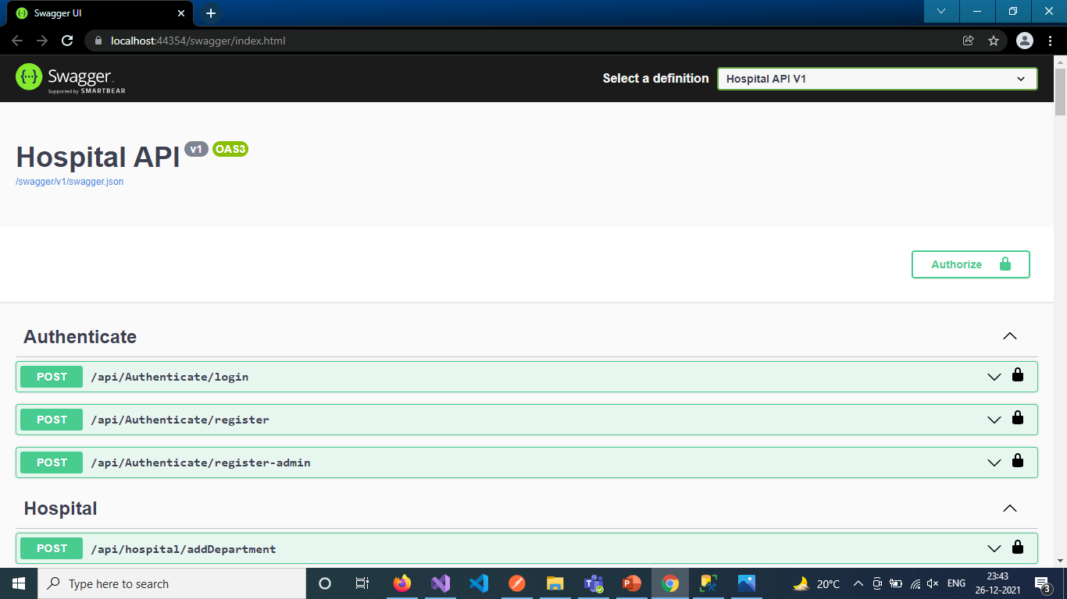

Slide 10
Admin Authentication
Admin Sign Up - https://localhost:44354/api/authenticate/register-admin
2. Login - https://localhost:44354/api/authenticate/login

Slide 11
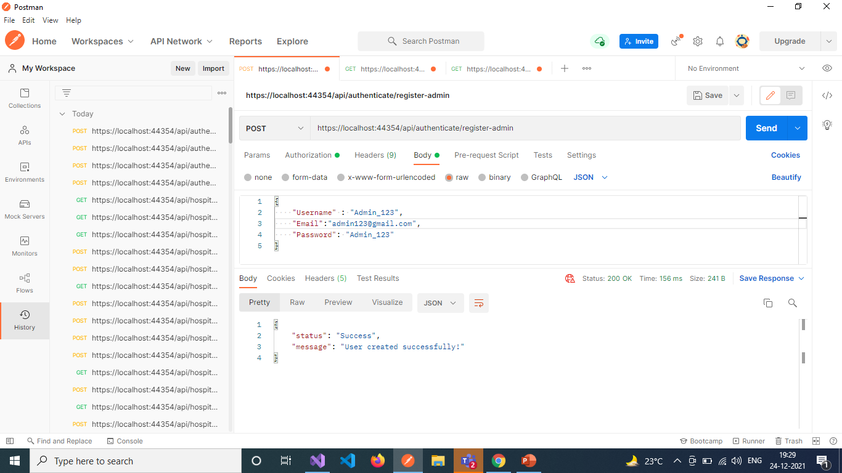

Slide 12
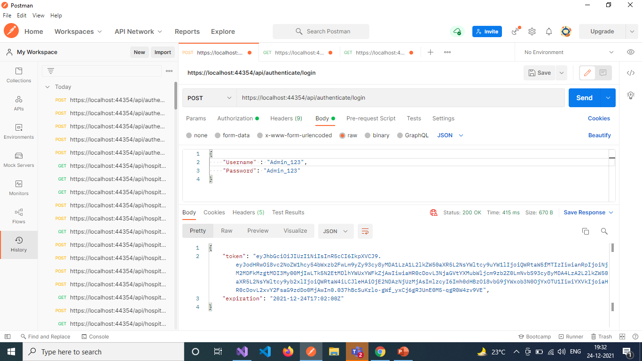

Slide 13
Admin Services [ With department ]
Add Department - https://localhost:44354/api/hospital/addDepartment
Get All Departments List - https://localhost:44354/api/hospital/getDepartments
Delete Department by Id - https://localhost:44354/api/hospital/deleteDepartment/{departmentId}

Slide 14
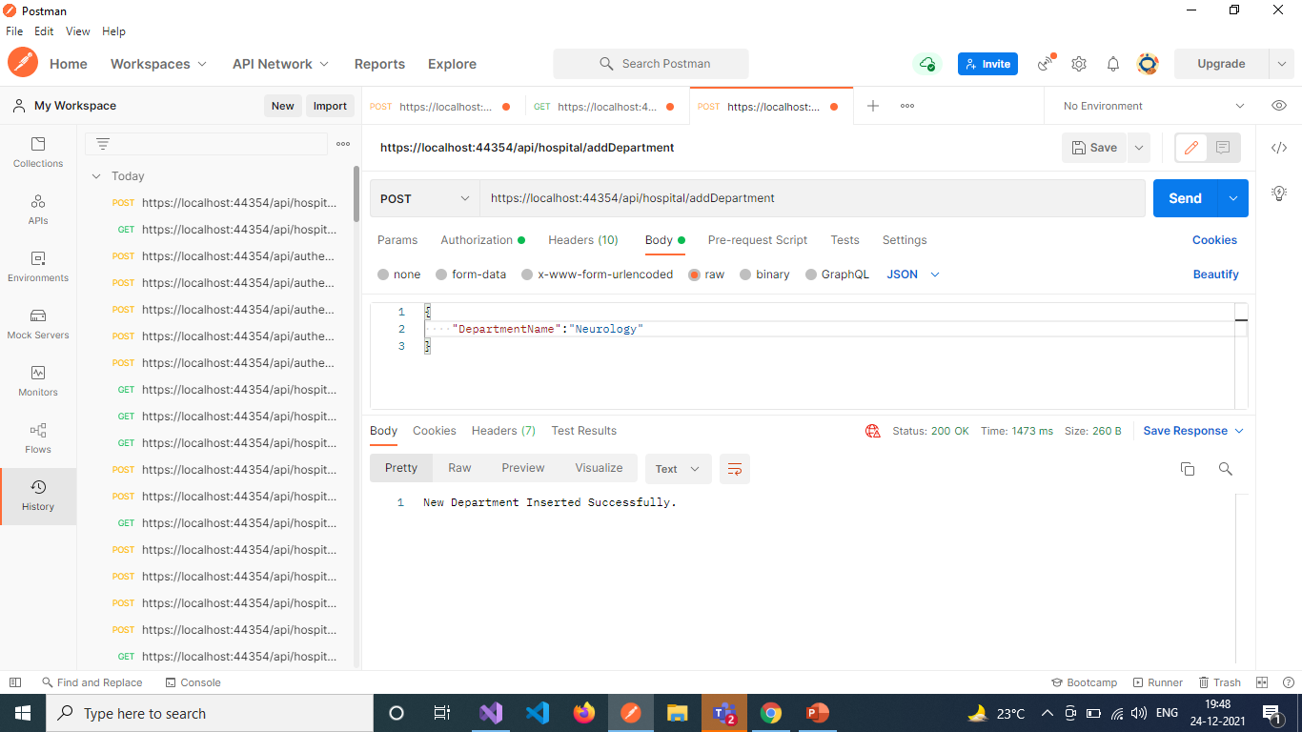

Slide 15
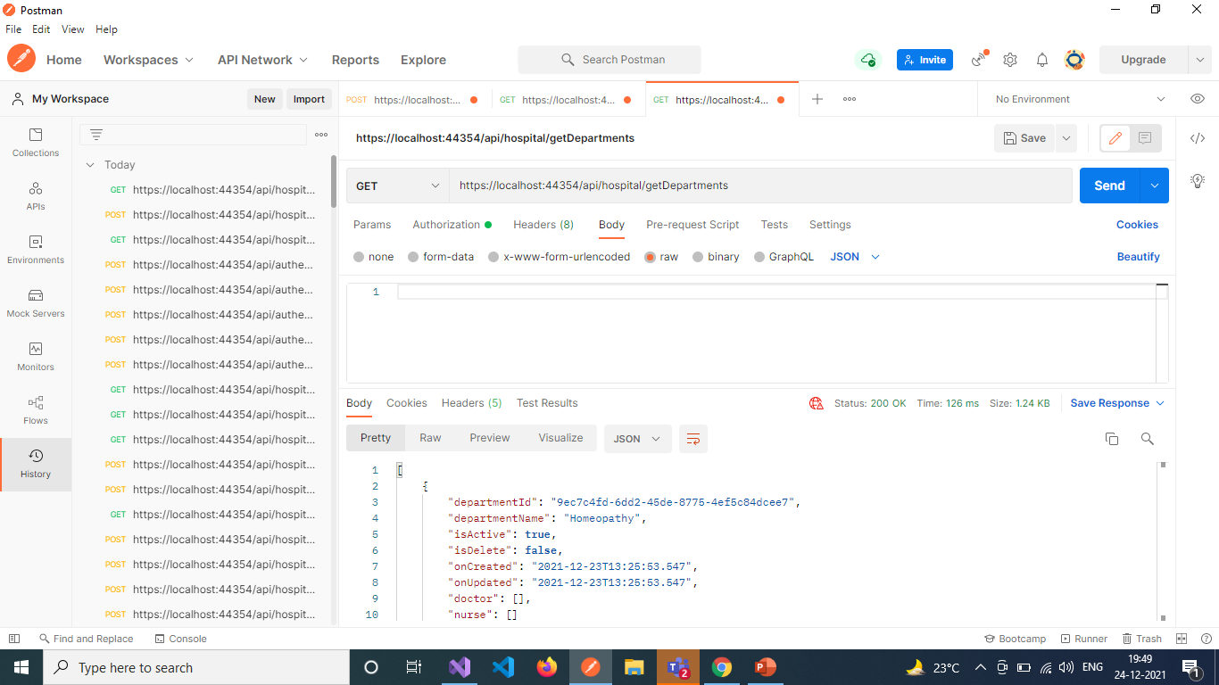

Slide 16
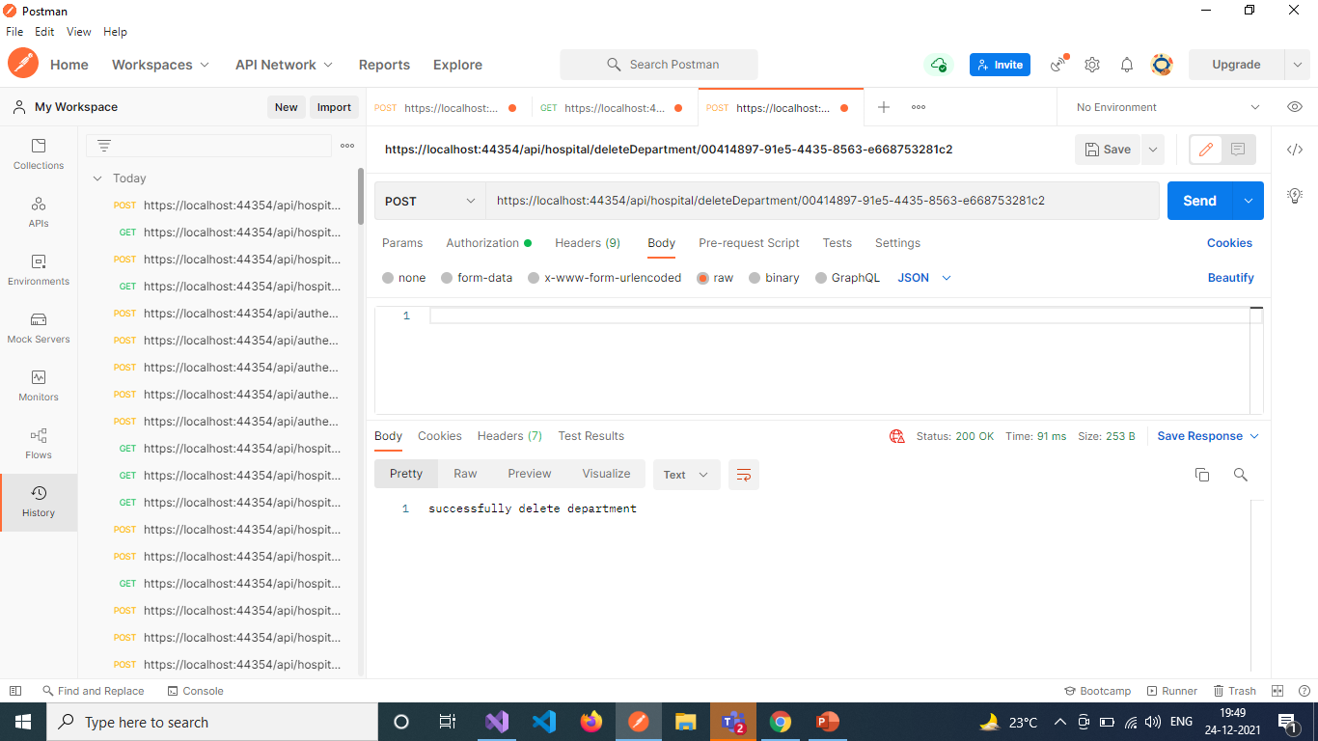

Slide 17
Admin Services [ with Doctor ]
Add New Doctor - https://localhost:44354/api/hospital/addDoctor
Update Doctor Details - https://localhost:44354/api/hospital/updateDoctor
Get All Doctors - https://localhost:44354/api/hospital/getDoctors
Get All Doctors with their Departments - https://localhost:44354/api/hospital/getDoctorDepartment
Get Doctor with Department by DoctorId - https://localhost:44354/api/hospital/getDoctorDepartment/{doctorId}
Delete Doctor by DoctorId - https://localhost:44354/api/hospital/deleteDoctor/{doctorId}

Slide 18
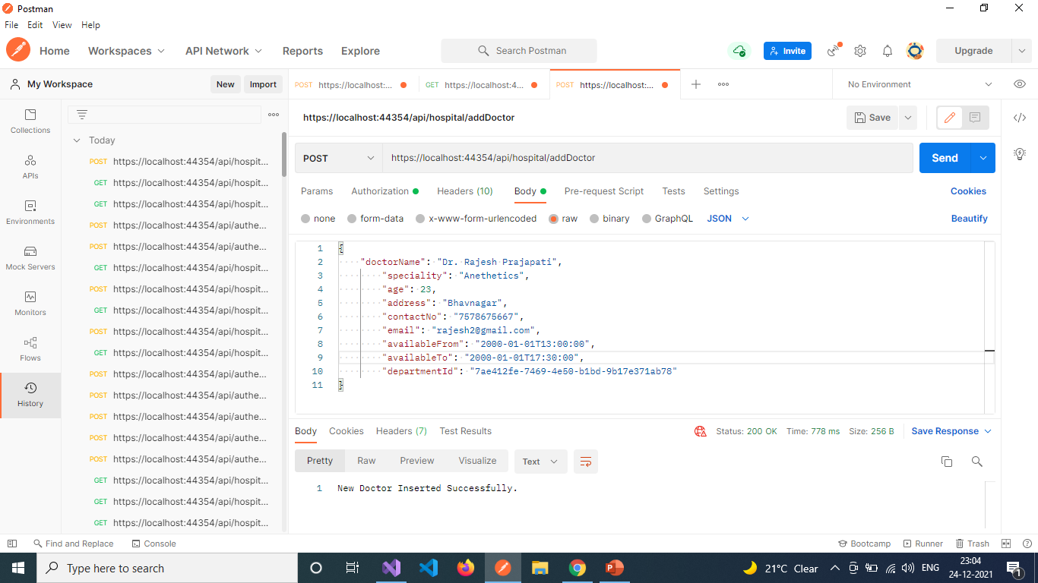

Slide 19
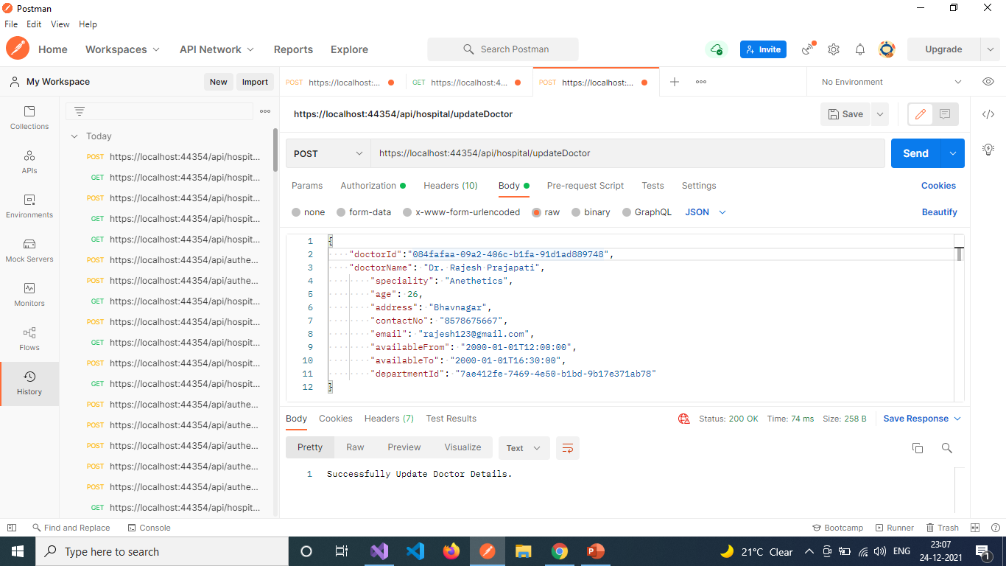

Slide 20
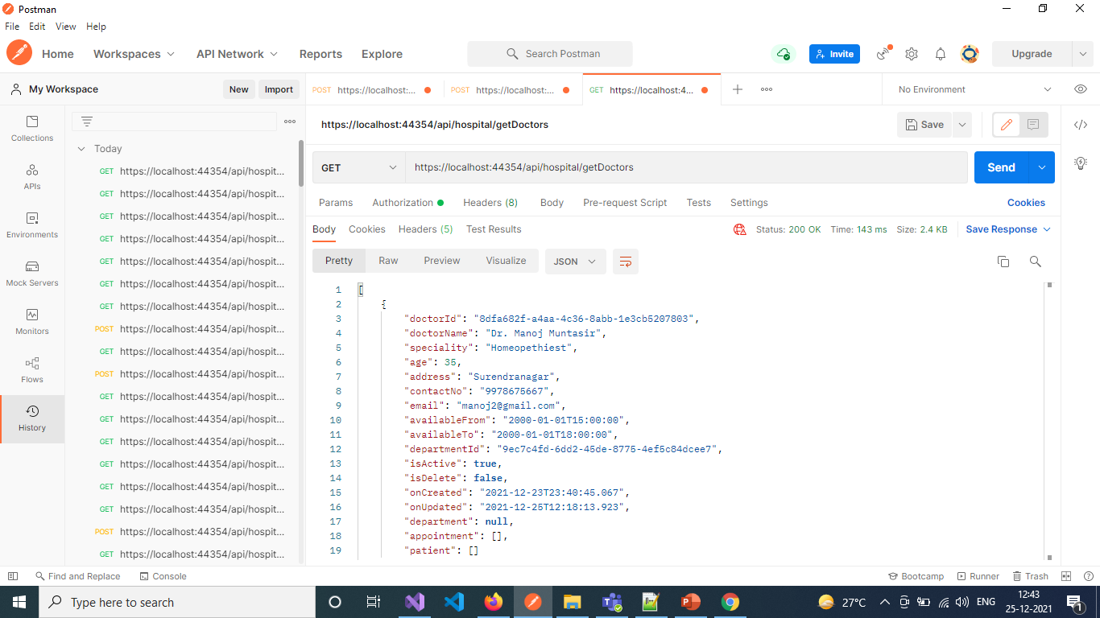

Slide 21


Slide 22
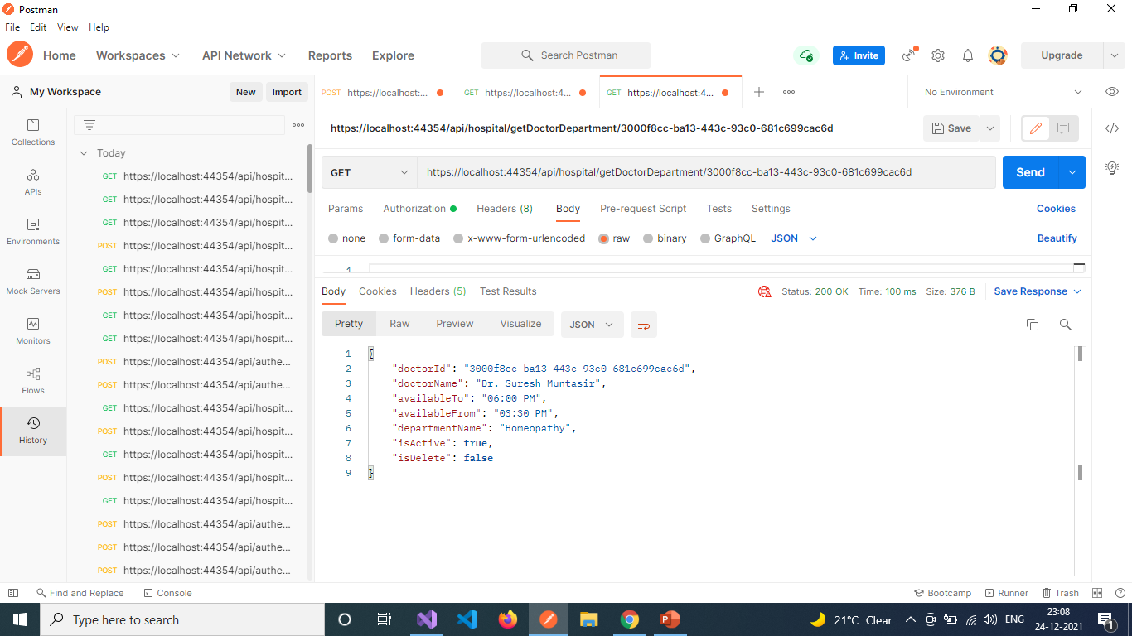

Slide 23
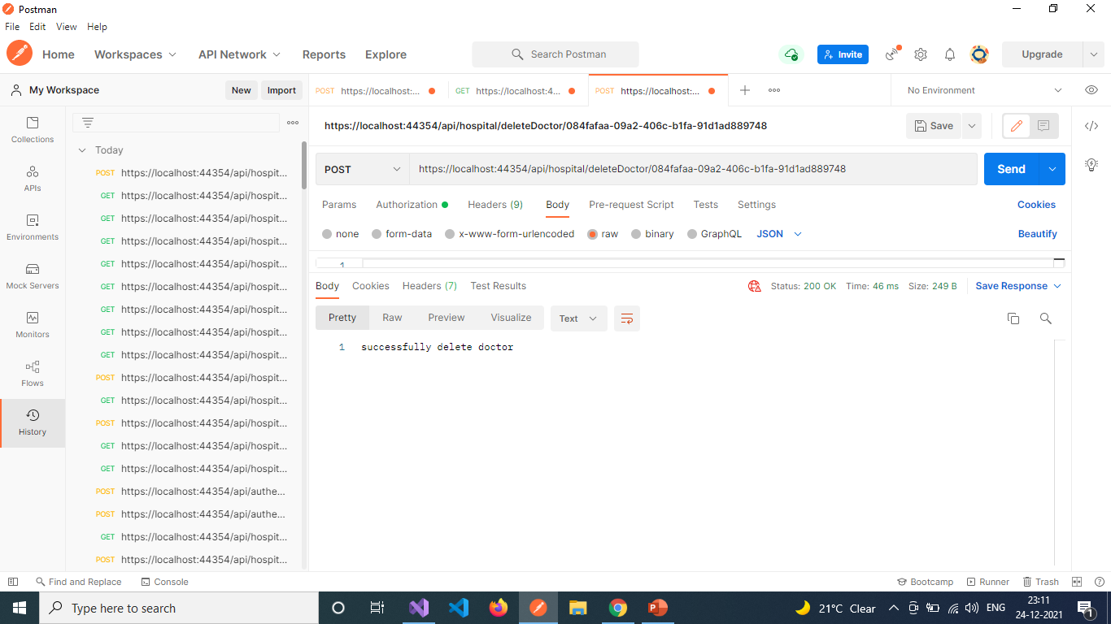

Slide 24
ADMIN Services [ with appointment ]
Add New Appointment - https://localhost:44354/api/hospital/addAppointment
Update Appointment - https://localhost:44354/api/hospital/updateAppointment
Get All Appointments List - https://localhost:44354/api/hospital/getAppointments
Get Appointment with Doctor - https://localhost:44354/api/hospital/getAppointmentDoctor
Get Appointment with Doctor By Id - https://localhost:44354/api/hospital/getAppointmentDoctor/{appointmentId}
Delete Appointment By Id - https://localhost:44354/api/hospital/deleteAppointment/{appointmentId}

Slide 25
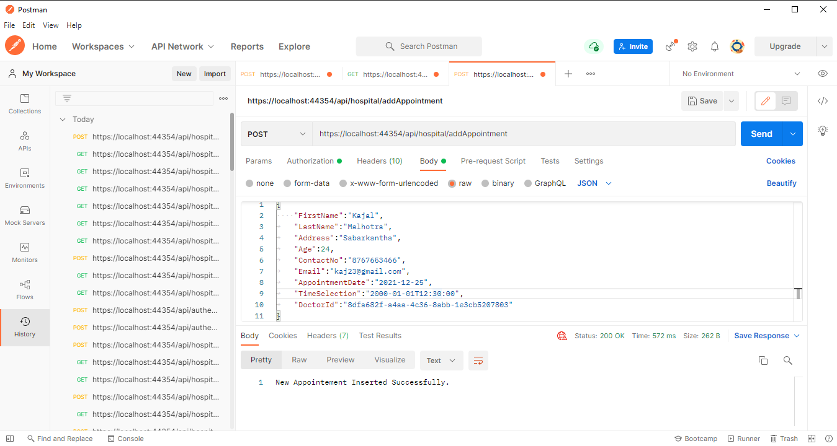

Slide 26
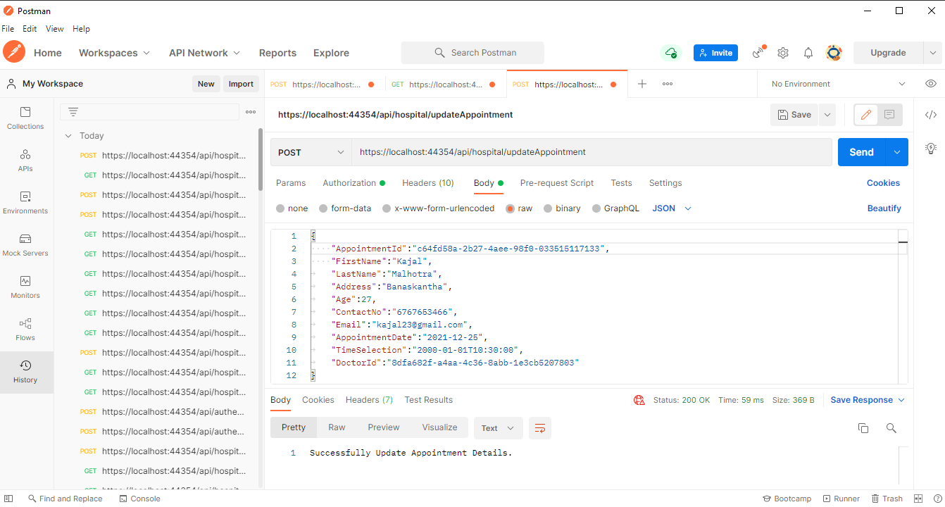

Slide 27
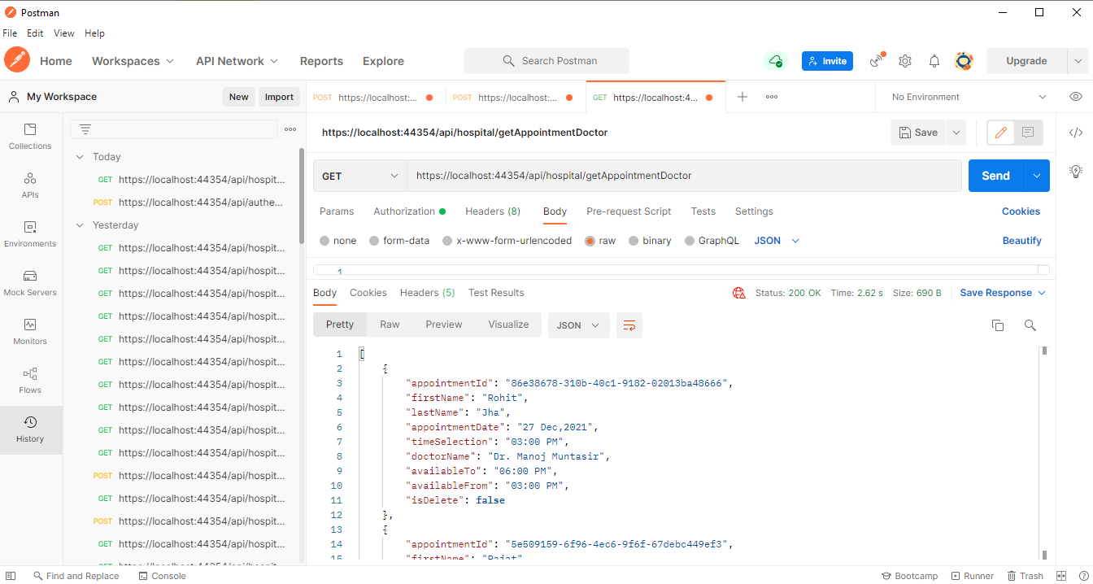

Slide 28
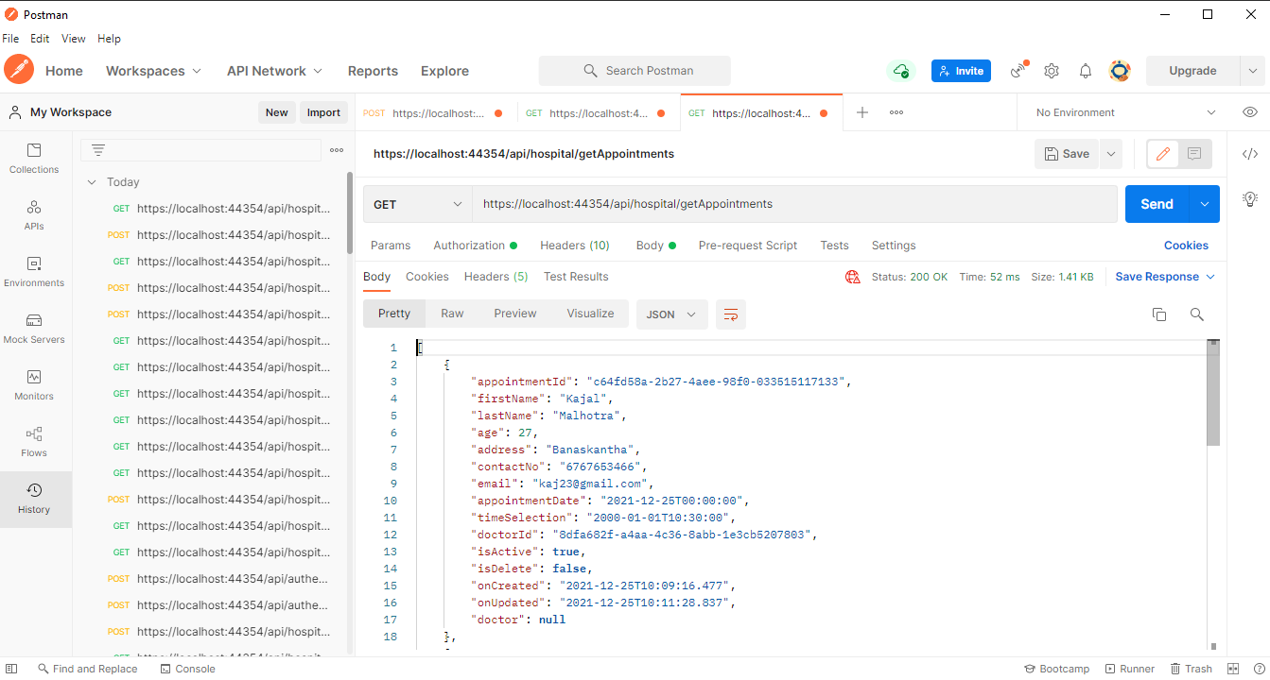

Slide 29
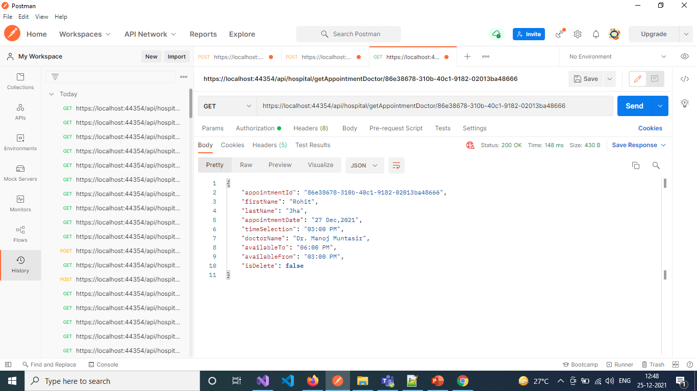

Slide 30
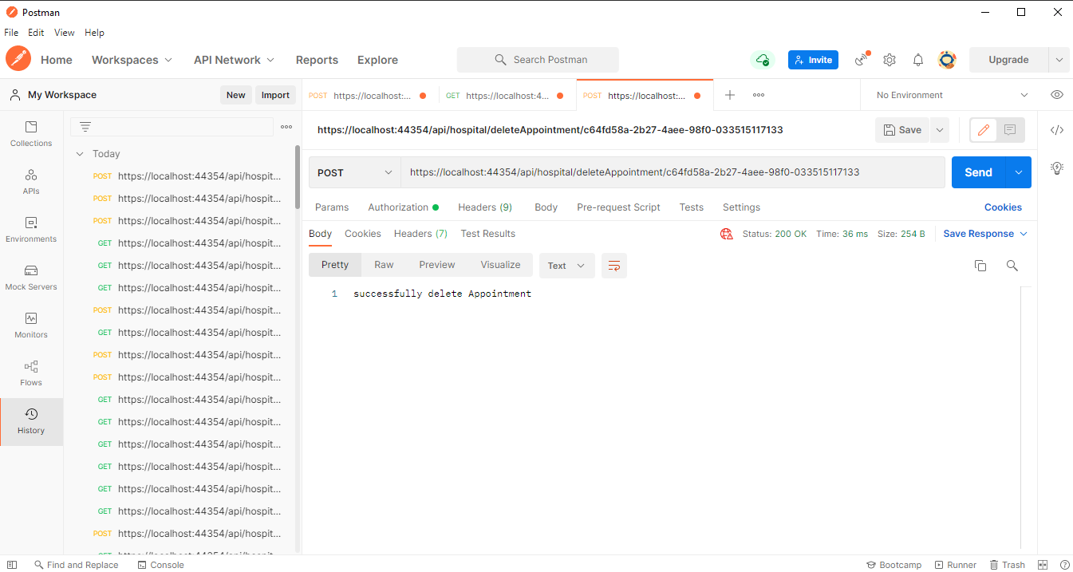

Slide 31
ADMIN Services [ with Nurse ]
Add New Nurse - https://localhost:44354/api/hospital/addNurse
Get All Nurses - https://localhost:44354/api/hospital/getNurses
Get Nurse with Department List - https://localhost:44354/api/hospital/getNurseDepartment
Get Nurse with Department By Id – https://localhost:44354/api/hospital/NurseDepartment/{nurseId}
Delete Nurse - https://localhost:44354/api/hospital/deleteNurse/{nurseId}

Slide 32
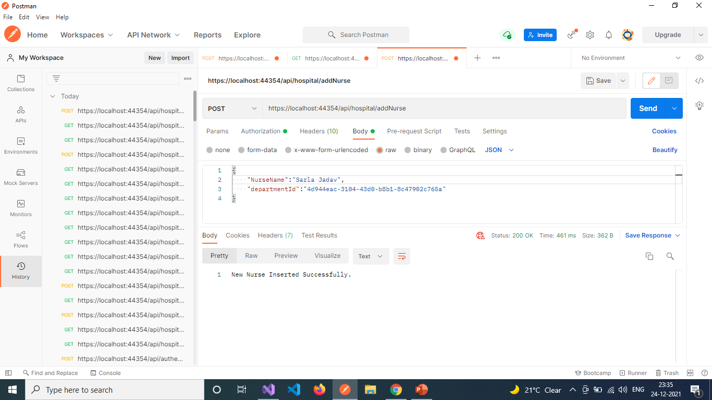

Slide 33


Slide 34
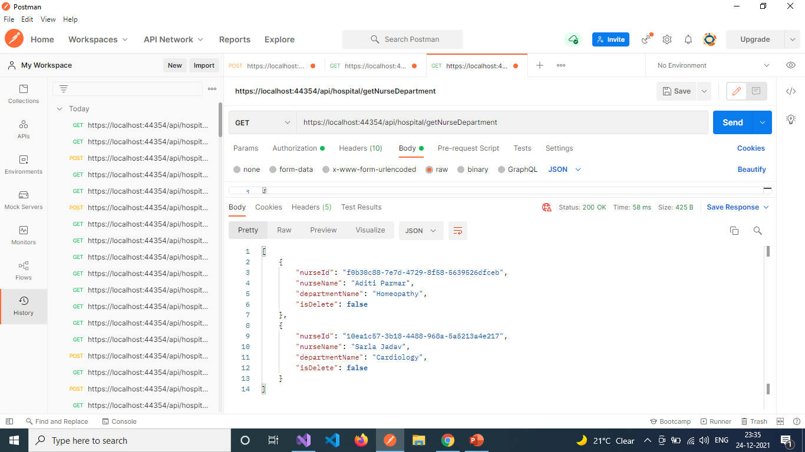

Slide 35
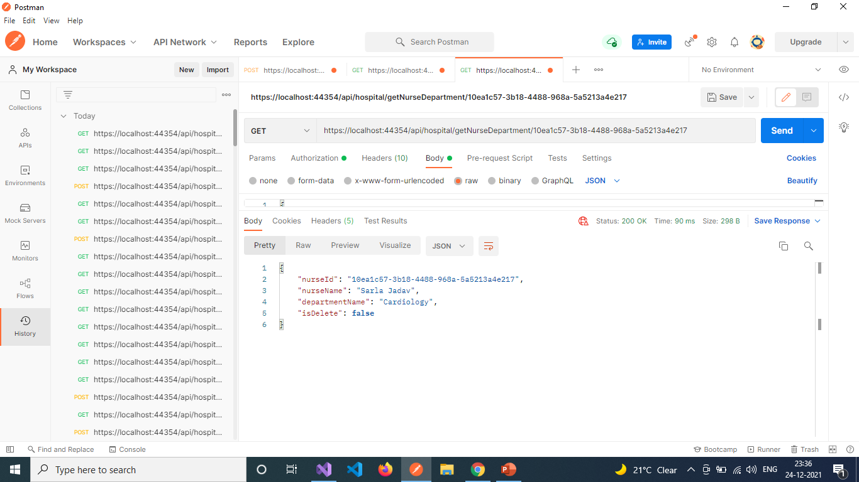

Slide 36
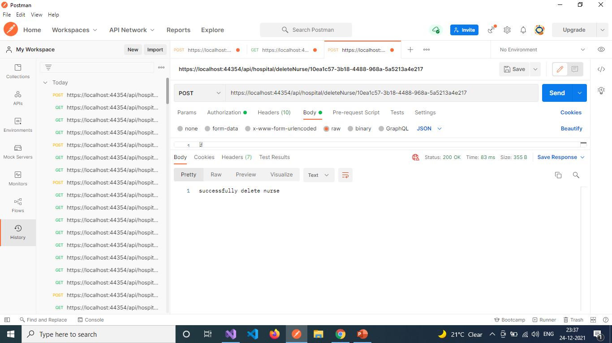

Slide 37
Admin Services [ with patient ]
Add New Patient - https://localhost:44354/api/hospital/addPatient
Update Patient Details - https://localhost:44354/api/hospital/updatePatient
Get All Patients List - https://localhost:44354/api/hospital/getPatients
Get List of Patient with Doctor - https://localhost:44354/api/hospital/getPatientDoctor
Get List Patient with Doctor and Nurse - https://localhost:44354/api/hospital/getPatientDoctorNurse
Get Patient with Doctor By Id - https://localhost:44354/api/hospital/getPatientDoctorNurse/{patientId}
Delete Patient - https://localhost:44354/api/hospital/deletePatient/{patientId}

Slide 38
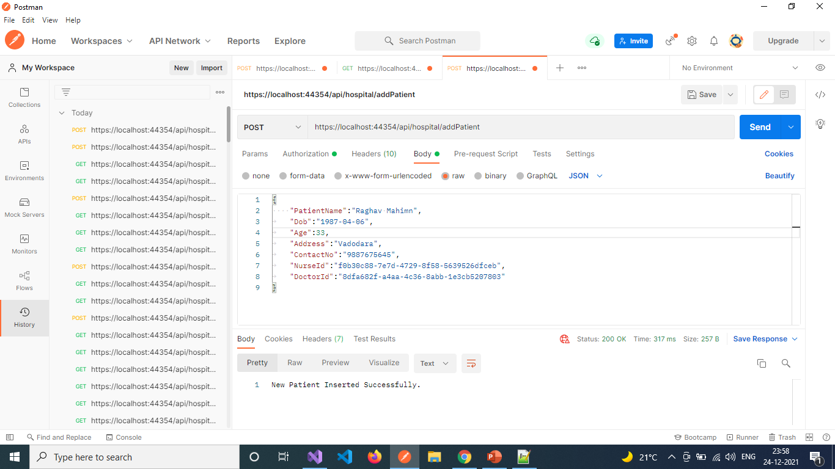

Slide 39
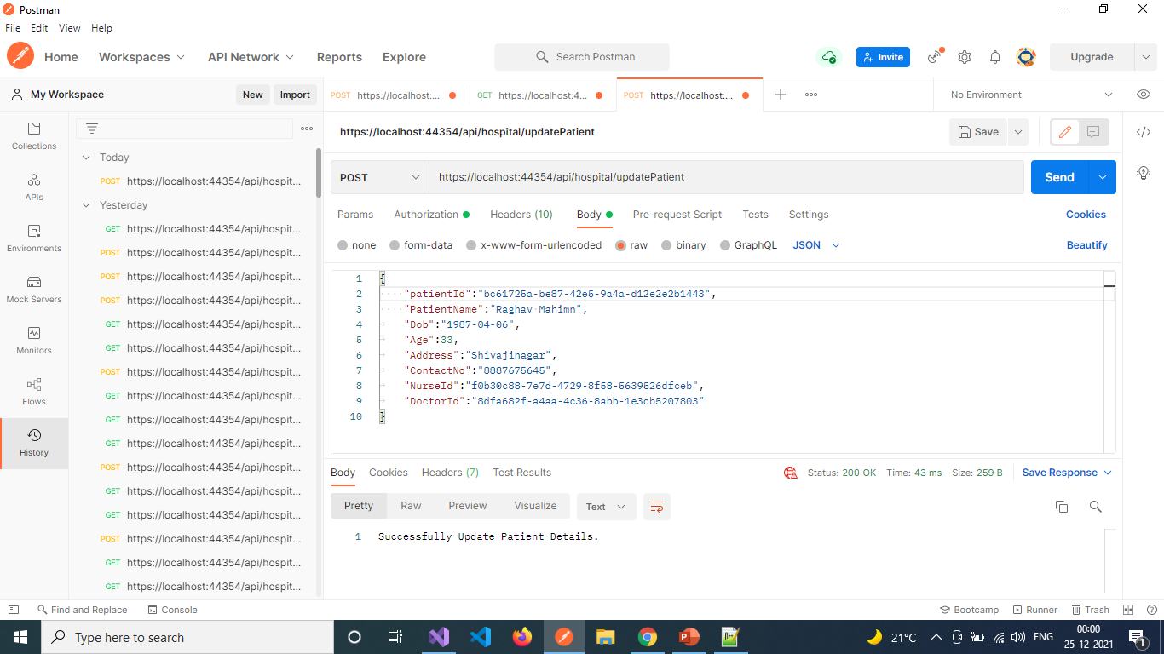

Slide 40
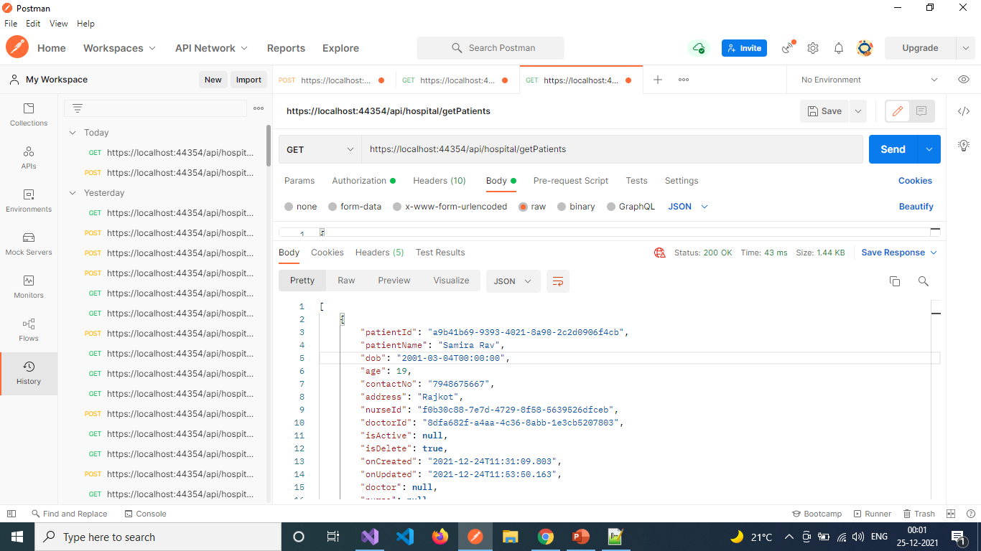

Slide 41


Slide 42


Slide 43


Slide 44
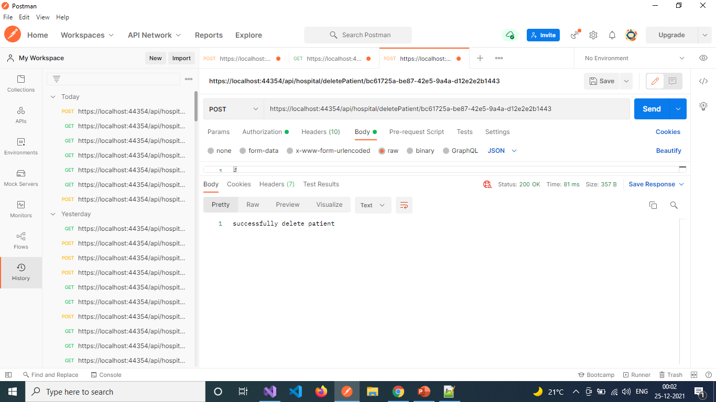

Slide 45
Admin services [ with medicine ]
Add Medicine – https://localhost:44354/api/hospital/addMedicine
Get Medicines – https://localhost:44354/api/hospital/getMedicines
Delete Medicine By Id - https://localhost:44354/api/hospital/deleteMedicine/{medicineId}

Slide 46
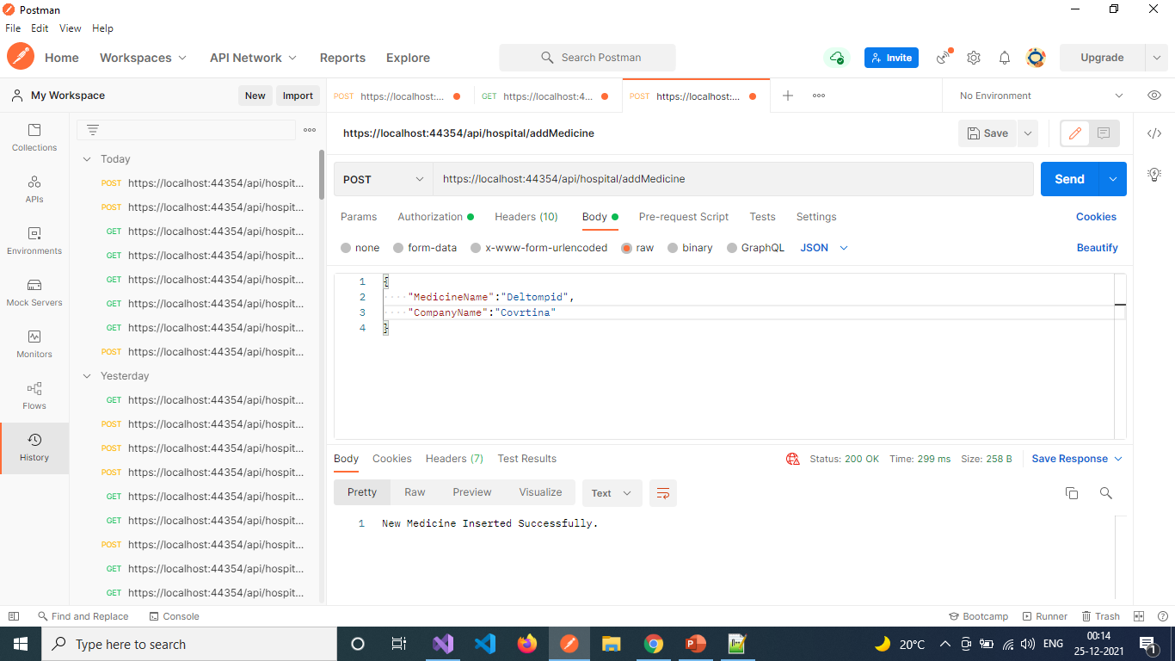

Slide 47
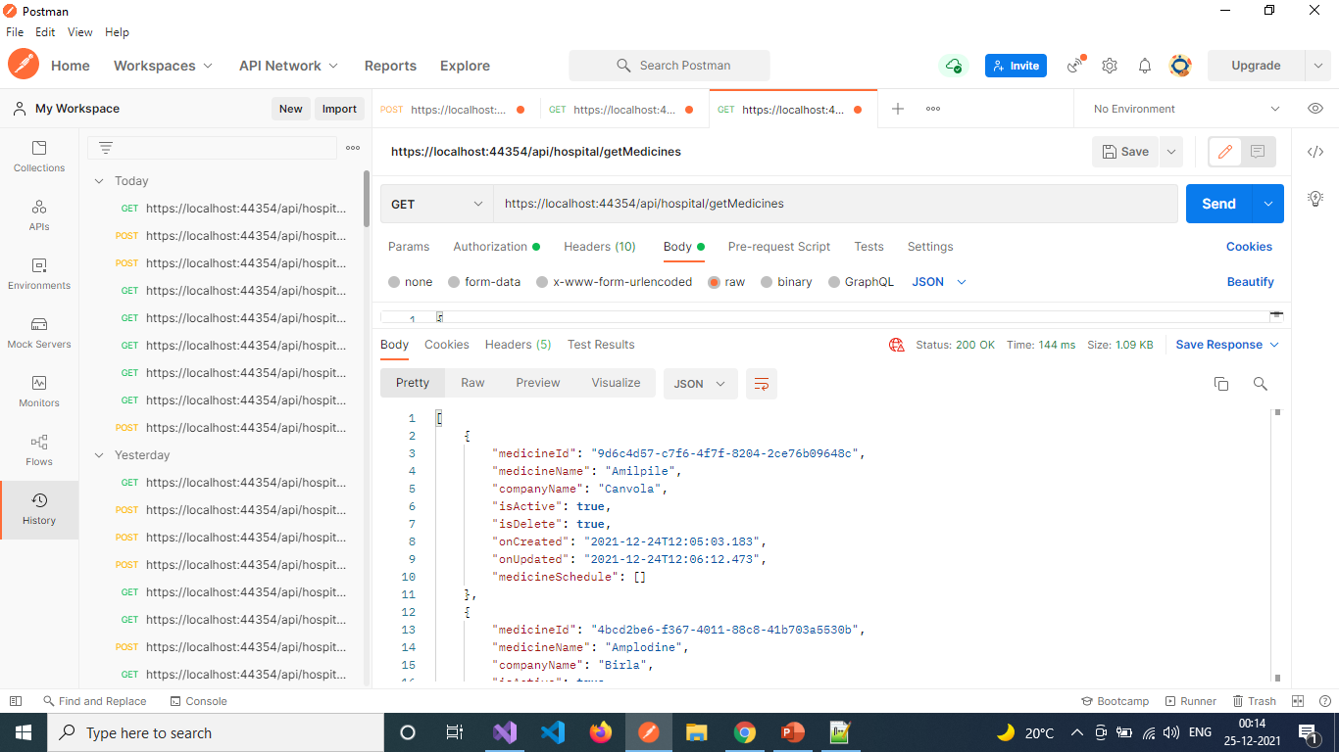

Slide 48


Slide 49
admin services [ with medicine schedule ]
Add Medicine Schedule - https://localhost:44354/api/hospital/addMedicineSchedule
Update Medicine Schedule - https://localhost:44354/api/hospital/updateMedicineSchedule
Get Medicine Schedule List - https://localhost:44354/api/hospital/getMedicineSchedule
Get List of Medicine Schedule with Patient – https://localhost:44354/api/hospital/getMedicineSchedulePatient
Get Medicine Schedule with Patient By Id - https://localhost:44354/api/hospital/getMedicineSchedulePatient/{medicineScheduleId}
Delete Medicine Schedule - https://localhost:44354/api/hospital/deleteMedicineSchedule/{medicineScheduleId}

Slide 50
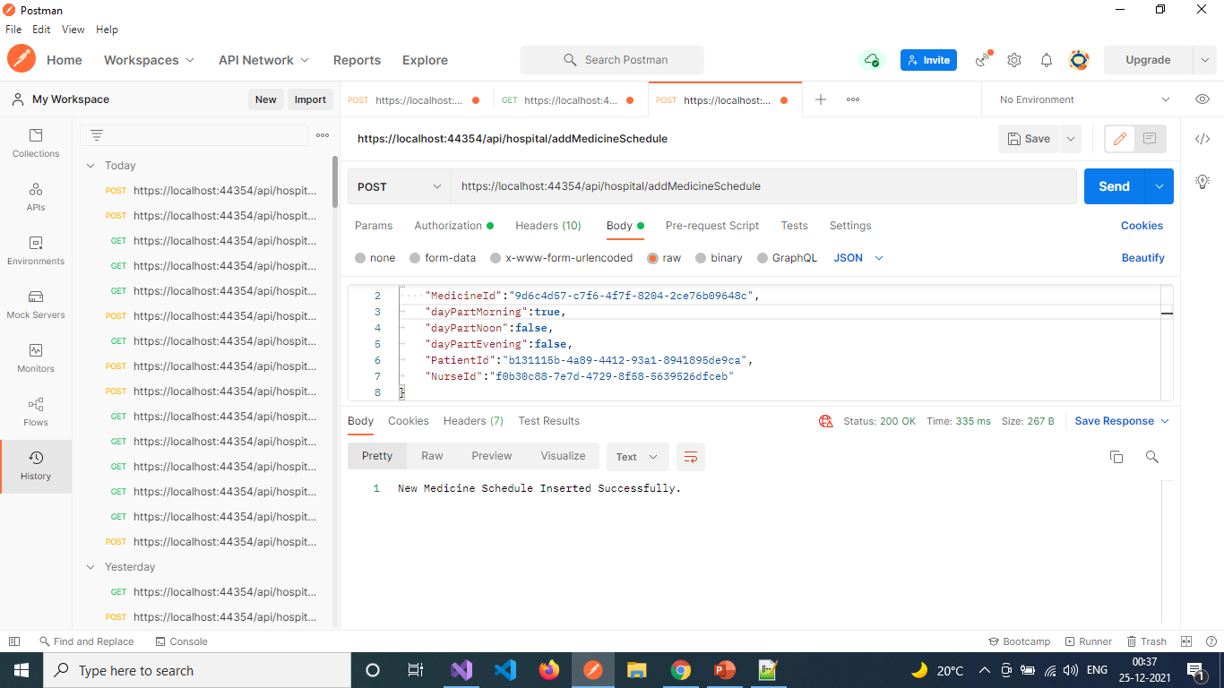

Slide 51
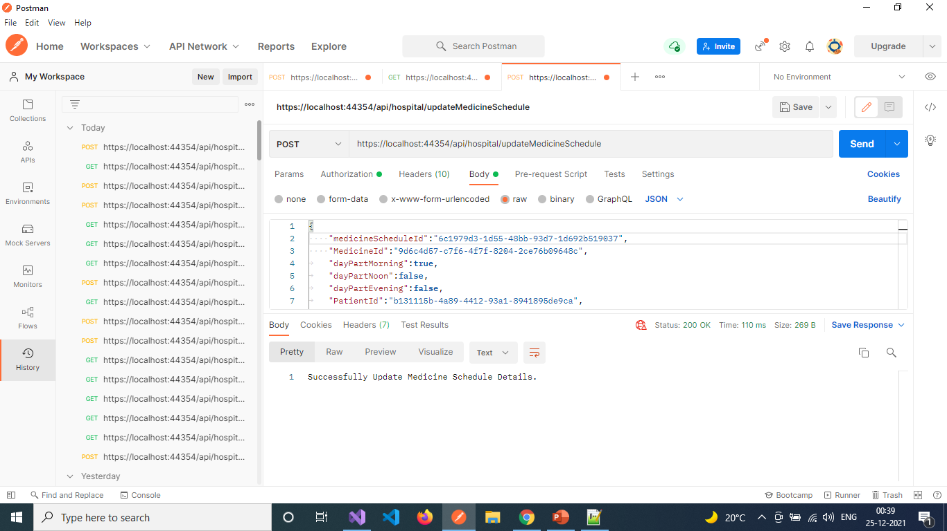

Slide 52
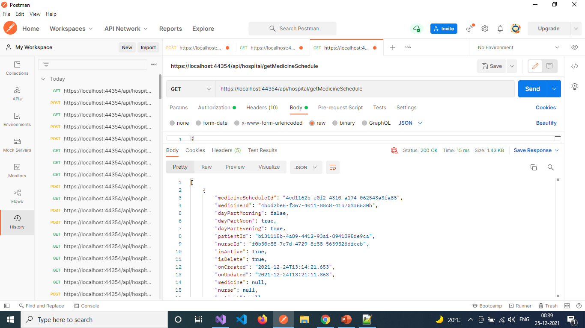

Slide 53
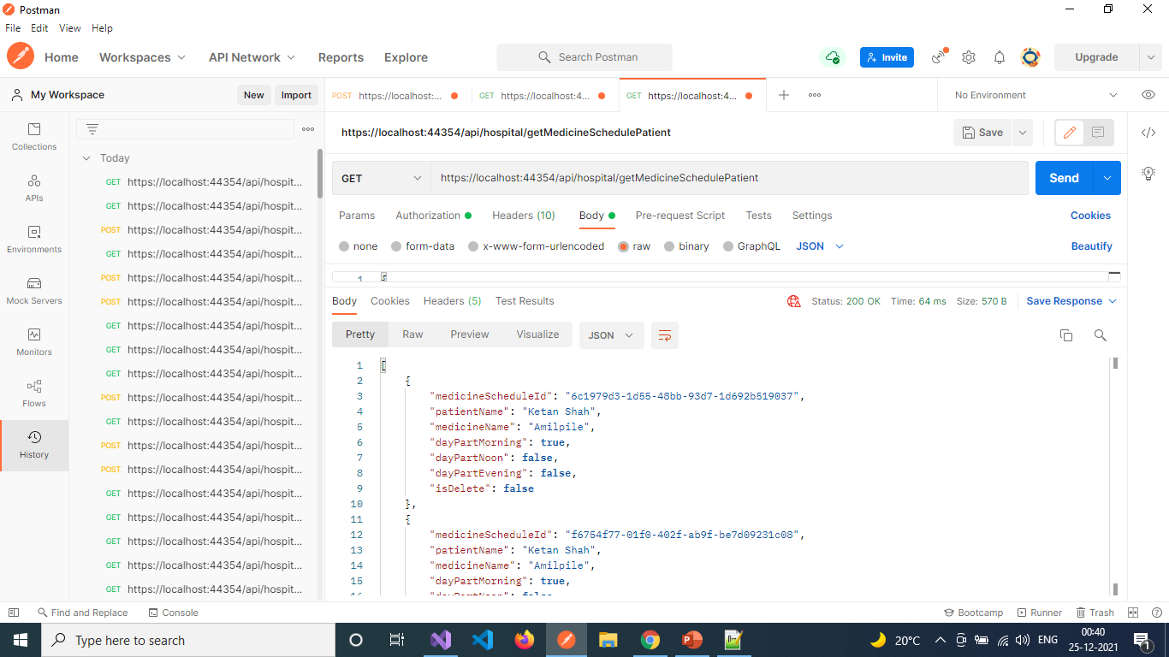

Slide 54
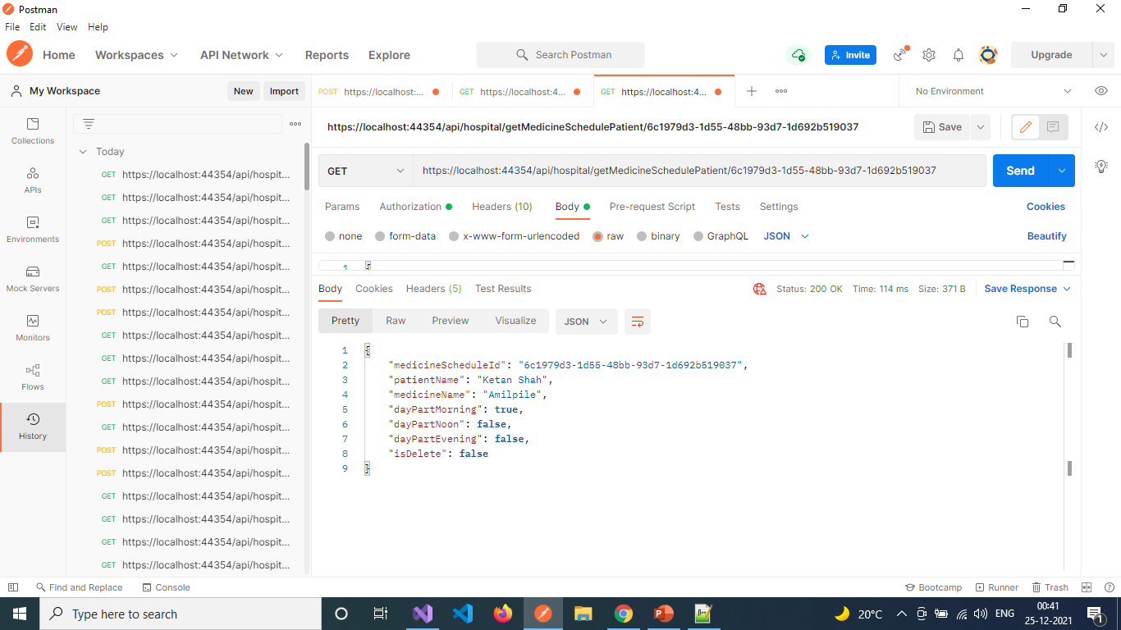

Slide 55
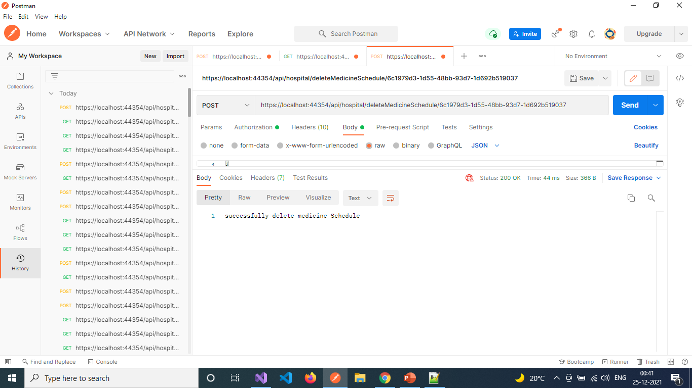

Slide 56
Admin Services [ with Report]
Add Report – https://localhost:44354/api/hospital/addReport
Update Report – https://localhost:44354/api/hospital/updateReport
Get All Reports – https://localhost:44354/api/hospital/getReports
Get Report with Patient and Doctor – https://localhost:44354/api/hospital/getReportPatientDoctor
Get Report with Patient and Doctor By Id – https://localhost:44354/api/hospital/getReportPatientDoctor/{reportId}
Delete Report - https://localhost:44354/api/hospital/deleteReport/{reportId}

Slide 57
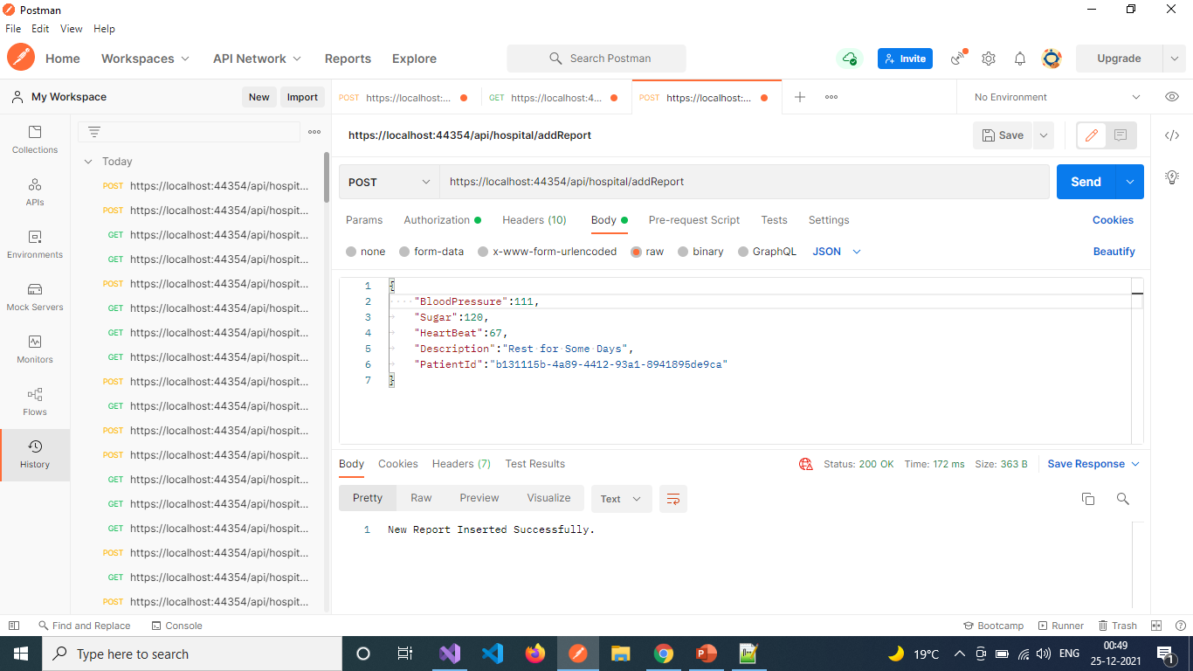

Slide 58


Slide 59
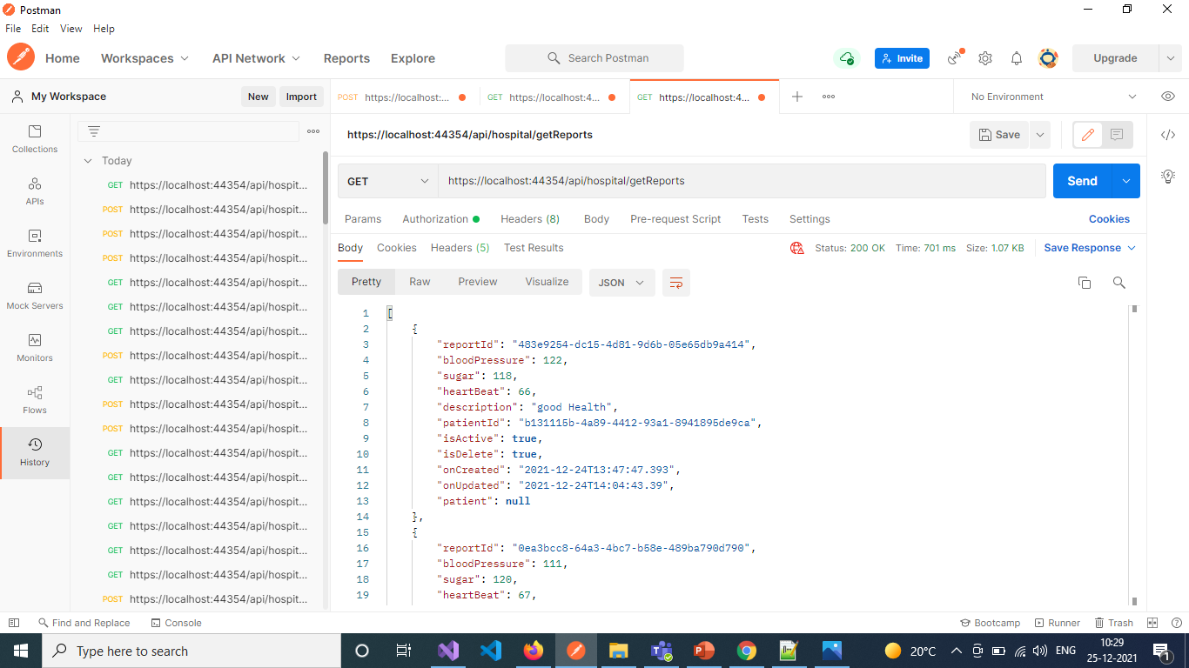

Slide 60


Slide 61


Slide 62
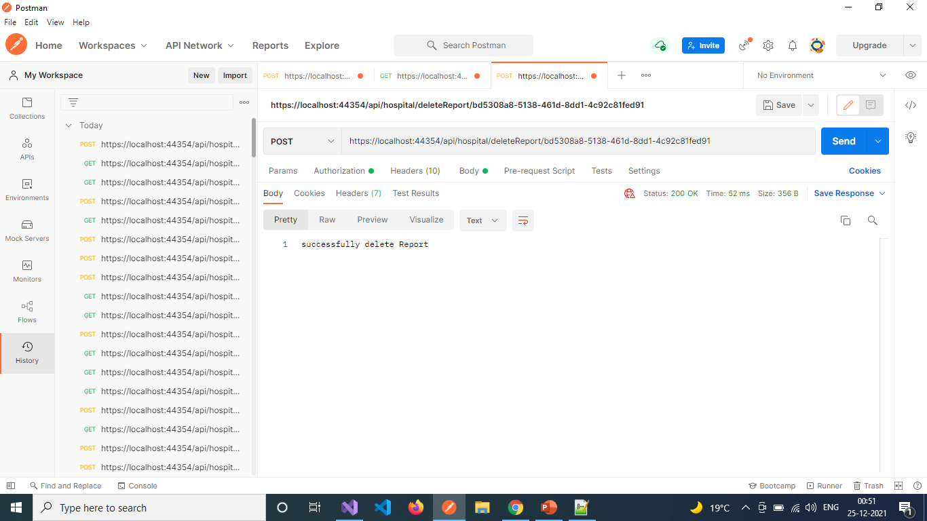

Slide 63
User Authentication
User Sign Up - https://localhost:44354/api/authenticate/register
User Login - https://localhost:44354/api/authenticate/login

Slide 64
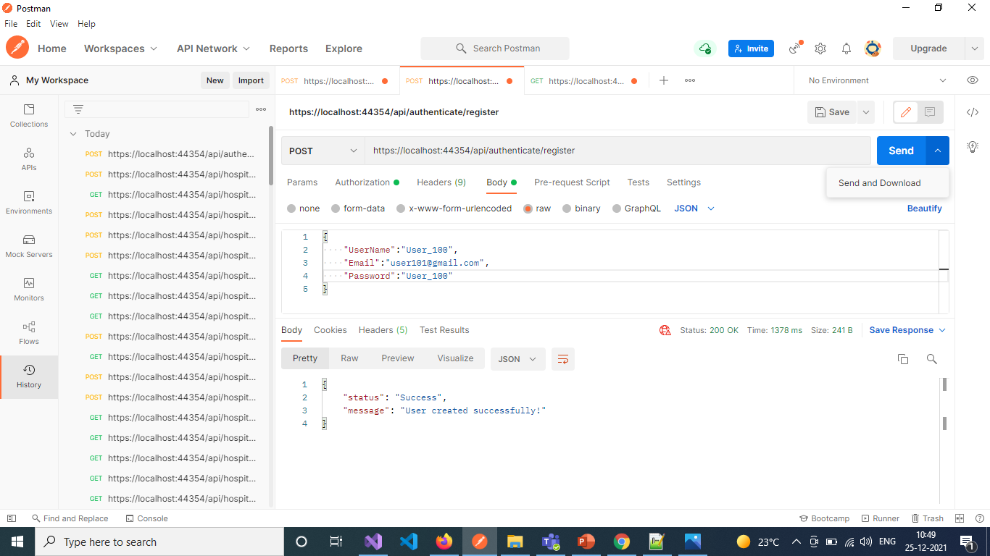

Slide 65
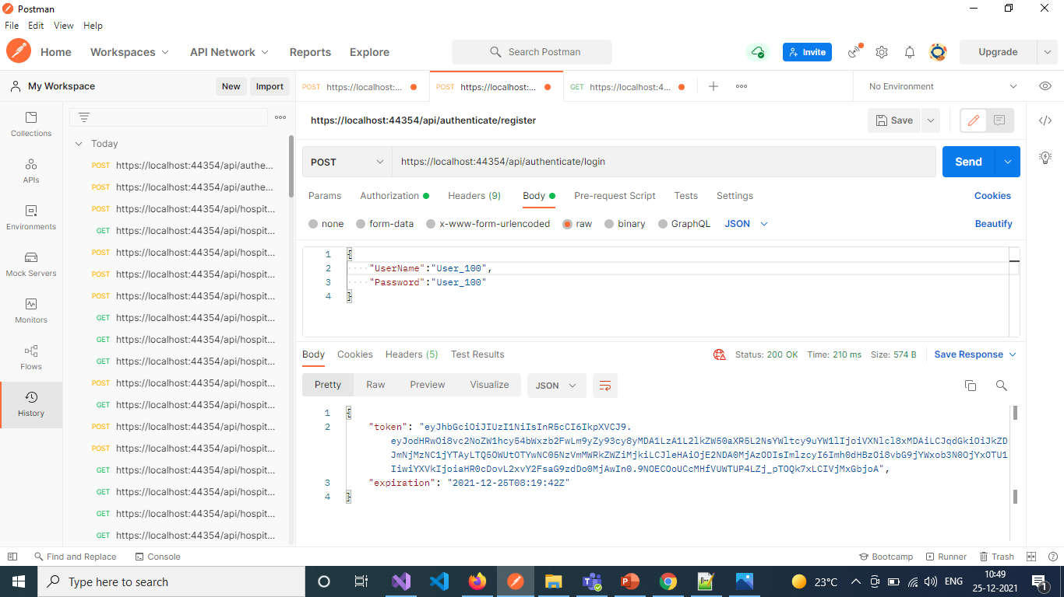

Slide 66
User services [ with department , doctor and nurse ]
Get All Departments List - https://localhost:44354/api/hospital/getDepartments
Get All Doctors with Departments - https://localhost:44354/api/hospital/getDoctorDepartment
Get Doctor with Department By Id - https://localhost:44354/api/hospital/getDoctorDepartment/{doctorId}
Get All Nurses with Departments - https://localhost:44354/api/hospital/getNurseDepartment
Get Nurse with Department By Id - https://localhost:44354/api/hospital/getNurseDepartment/{nurseId}

Slide 67


Slide 69
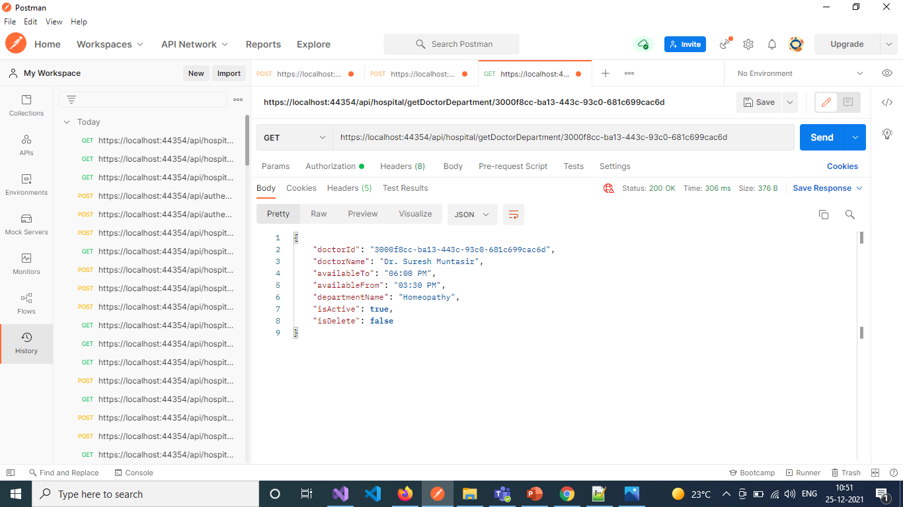

Slide 70
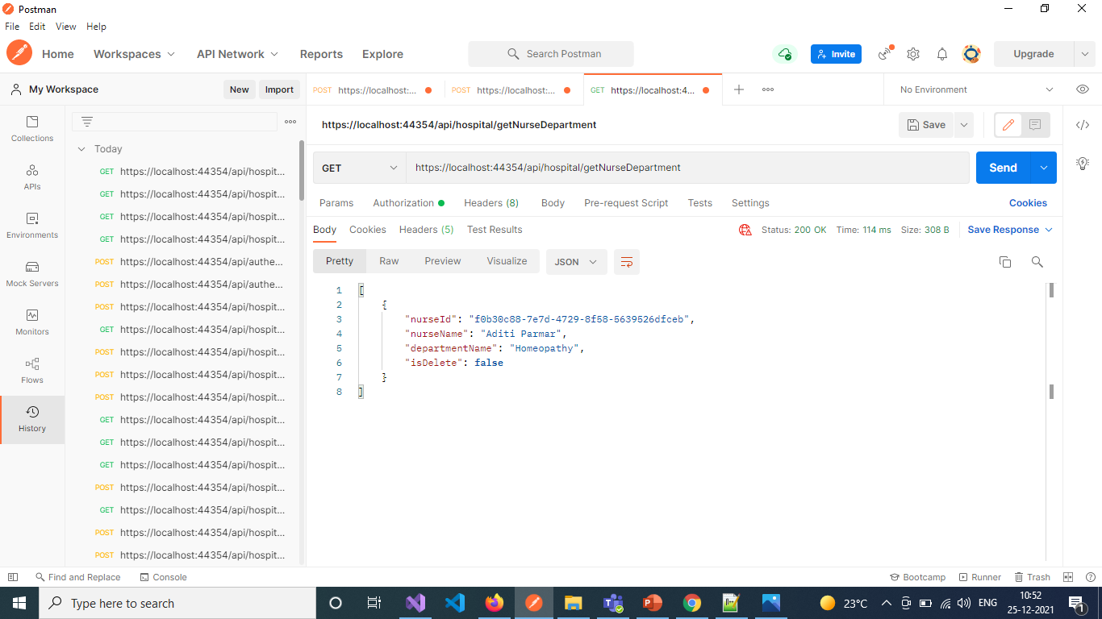

Slide 71
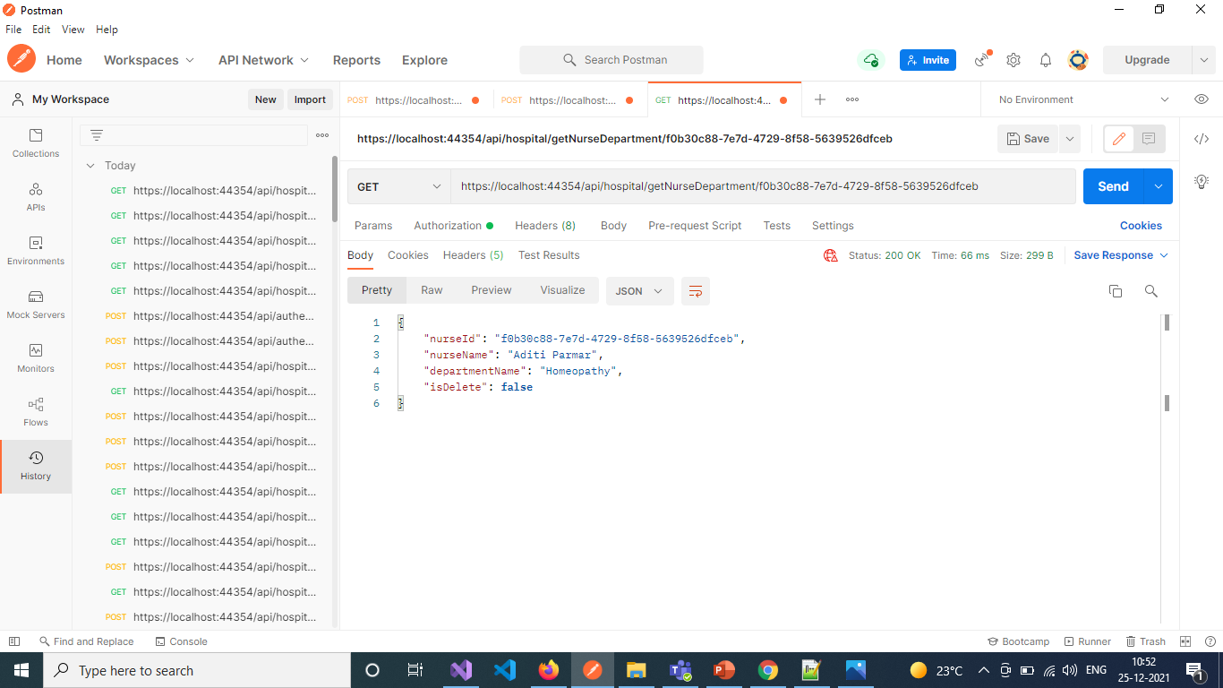

Slide 72
user services [ with appointment ]
Take New Appointment - https://localhost:44354/api/hospital/addAppointment
Update an Appointment - https://localhost:44354/api/hospital/updateAppointment
Get Appointment with Doctor By Id - https://localhost:44354/api/hospital/getAppointmentDoctor/{appointmentId}

Slide 73
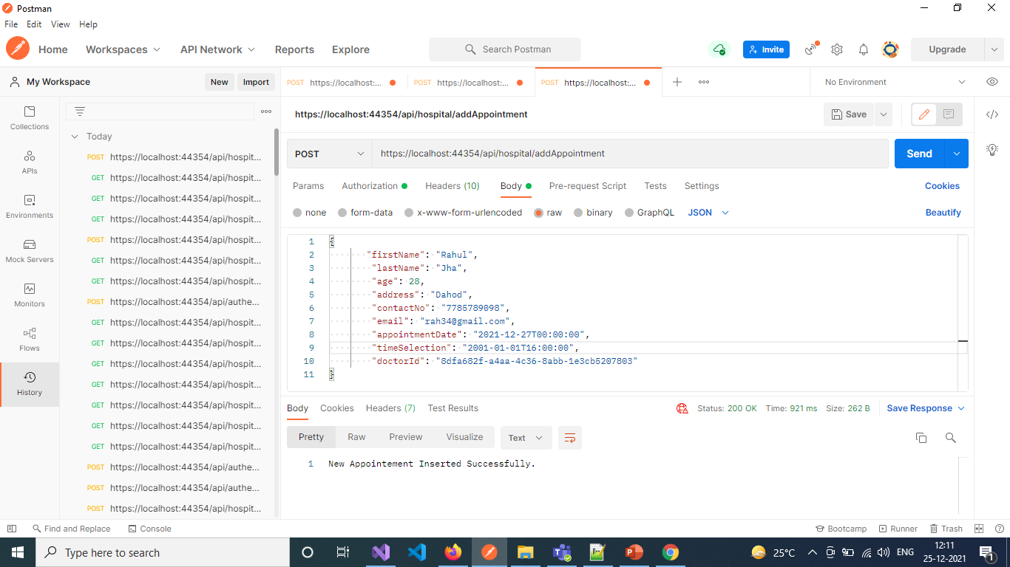

Slide 74
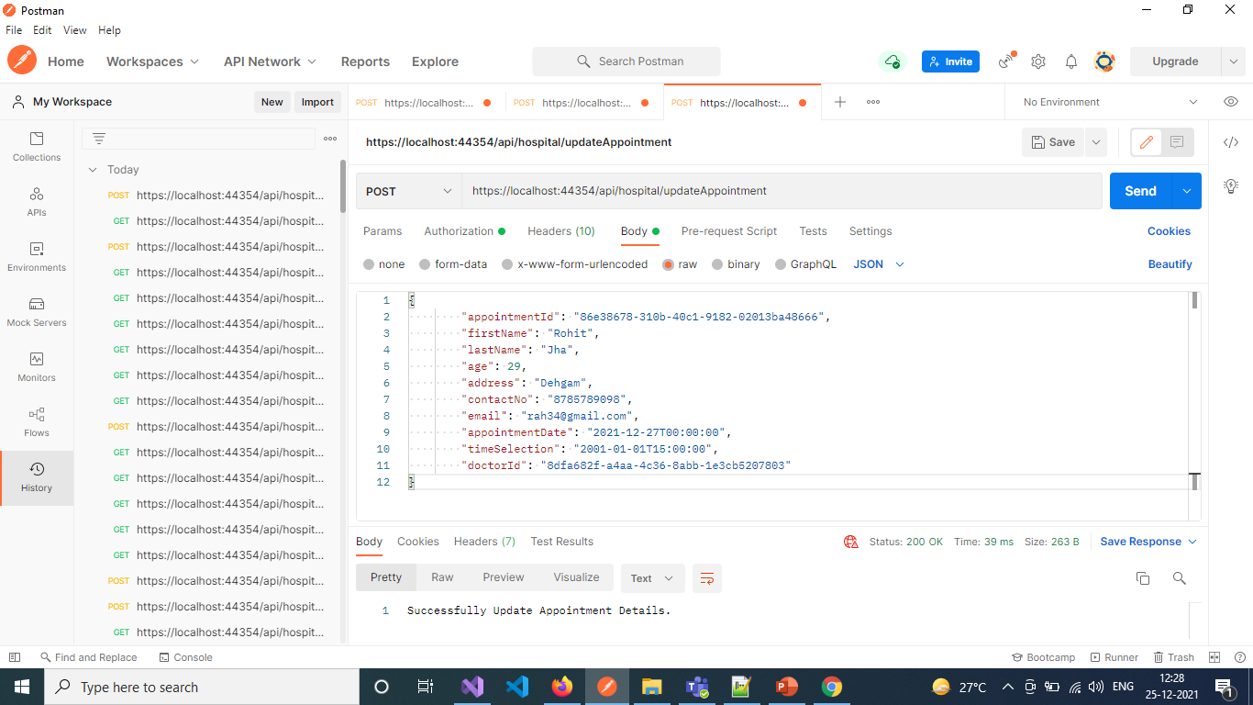

Slide 75


Slide 76
user services [ with patient , Medicine Schedule , Report ]
Get Patient with Doctor and Nurse By Id - https://localhost:44354/api/hospital/getPatientDoctorNurse/{patientId}
Get Medicine Schedule with Patient By Id - https://localhost:44354/api/hospital/getMedicineSchedulePatient/{medicineScheduleId}
Get Report of Patient with Doctor By Id - https://localhost:44354/api/hospital/getReportPatientDoctor/{reportId}

Slide 77


Slide 78
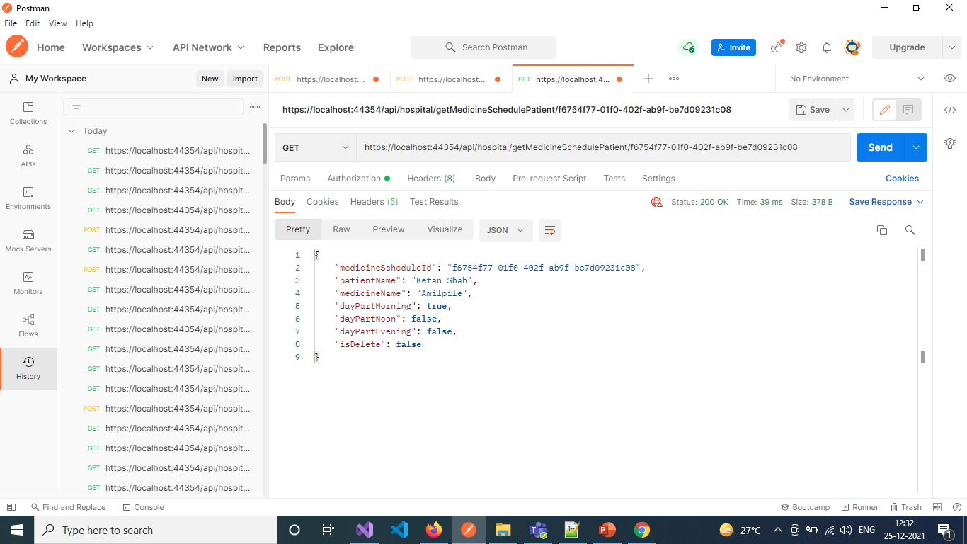

Slide 79


Slide 80
Note : -
Get All Doctors - https://localhost:44354/api/hospital/getDoctors
Get All Appointments List - https://localhost:44354/api/hospital/getAppointments
Get All Nurses List - https://localhost:44354/api/hospital/getNurses
Get All Patients List - https://localhost:44354/api/hospital/getPatients
Get All Medicines List - https://localhost:44354/api/hospital/getMedicines
Get All Medicine Schedules - https://localhost:44354/api/hospital/getMedicineSchedule
Get All Reports - https://localhost:44354/api/hospital/getReports
Above API’s , Admin can get Deleted items ,also.

Slide 81
THANK YOU
THANK YOU

